Slide 1
Introduction to C++
Sivaprasad Tamatam

Slide 2
History of C++
C with classes
1979 – Bjarne Stroustrup
C++
1983 – Officially named C++
C++ 98
1998
Introduction of Lambda Expressions, Delegating Constructors, Uniform Initialization Syntax, nullptr, Automatic Type Deduction and decltype, Rvalue References etc.
C++ 0X
2009
Introduction of polymorphic lambdas, digit separators, generalized lambda capture, variable templates, binary integer literals, quoted strings etc.
C++ 11
2011
Introduction of fold expressions, hexadecimal floating point literals, a u8 character literal, selection statements with initializer, inline variables etc.
C++ 14
2014
C++ 17
2017
C++ 20
2018 – In development

Slide 3
Why C++?
Conciseness: programming languages allow us to express common sequences of commands more concisely.
Maintainability: modifying code is easier when it entails just a few text edits, instead of rearranging hundreds of processor instructions. C++ is object oriented, which further improves maintainability.
Portability: different processors make different instructions available. Programs written as text can be translated into instructions for many different processors; one of C++’s strengths is that it can be used to write programs for nearly any processor
C++ does give access to some lower-level functionality than other languages

Slide 4
Computers are everywhere
C++
Gadgets
Shipping
Automotive
Medicine
Information
Telecom

Slide 5
The Compilation Process
A program goes from text files (or source files) to processor instructions as follows:
Source File/Code(.cpp)
Compiler
Object File(.obj)
Linker
Executable(.exe)

Slide 6
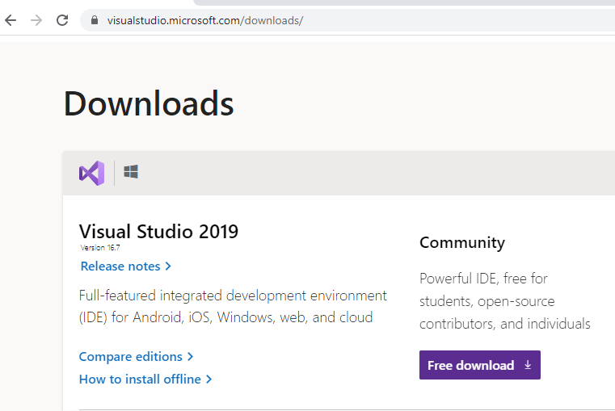
Build Environment
Download Visual Studio 2019 from below link https://visualstudio.microsoft.com/downloads/

Slide 7
Start a C++ Program
Hello World

Slide 8
Thank you..!

